Slide 1

Government Policies
And
Public sentiments
BIA-667
Introduction to Deep Learning
and Business Applications
Instructor: Rong Liu
By- Group C
Archana Kalburgi
Darpan Shah
Rajiv Mahajan
Siddharthan Chitra Suseendran

Slide 2
Research Problem
Insights into the emotional impact of the following six different categories of government policies to combat covid-19
Mass gathering 4. Mask mandate
2. Health testing 5. Business restriction
3. Lockdown 6. Vaccine

Slide 3
Motivation
It has been established in recent studies that sentiments like fear, sadness, anger are associated with the mental health of the people. So, it may be beneficial to study the impact of the emotion and their scores and how they are changing over time. It is our hope that our predictions will help in examining the state of public mental health.

Slide 4
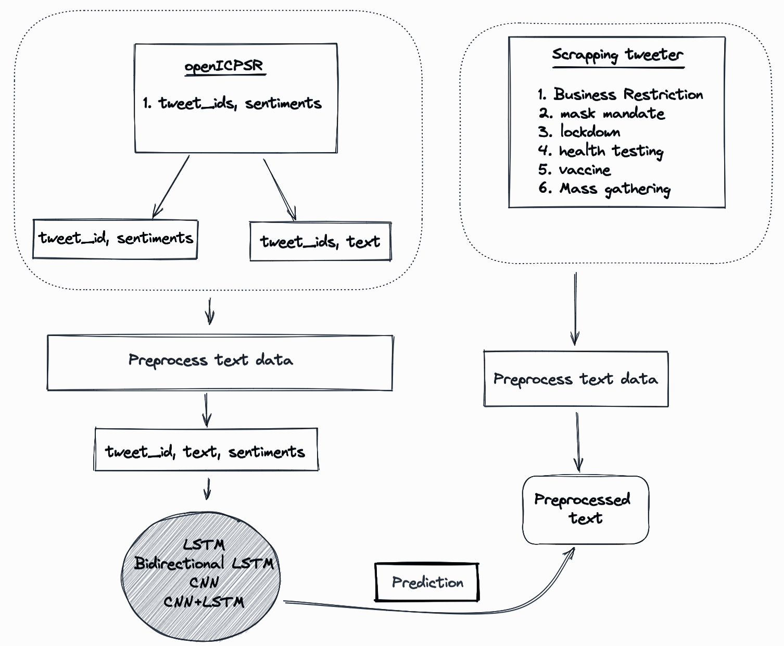
Workflow

Slide 5
Data Pre-Processing
Data Crawling
Data Cleaning
Tokenization + Lemmatization
We Scraped Twitter Data using SNS scraper.
Data sources are Inter-University Consortium for political and social research (ICPSR), Twitter Social media platform
Data includes 6 categories of policies and their relative tweets
Remove null values
Converted date column to datetime format
removed punctuations and lowered whole character
remove stop-words
Tokenized the data to get useful keywords
Lemmatized the data to make it uniform
Removed columns which are not included in the analysis

Slide 6
Exploratory Data Analysis (EDA)
Data collected from 28 January 2020 to 1 September 2021. It has over 198 million Twitter posts from more than 25 million unique users using four keywords: “corona”, “wuhan”, “nCov” and “covid
Each tweet is being labeled with five quantitative emotion attributes indicating the degree of intensity of the valence or sentiment
We subset the data in order to use it in the context of our study. In order to get the labeled sentiments, we have taken advantage of the data that is central to the United States which has 929,337 data points. A snippet of the same can be found below:

Slide 7
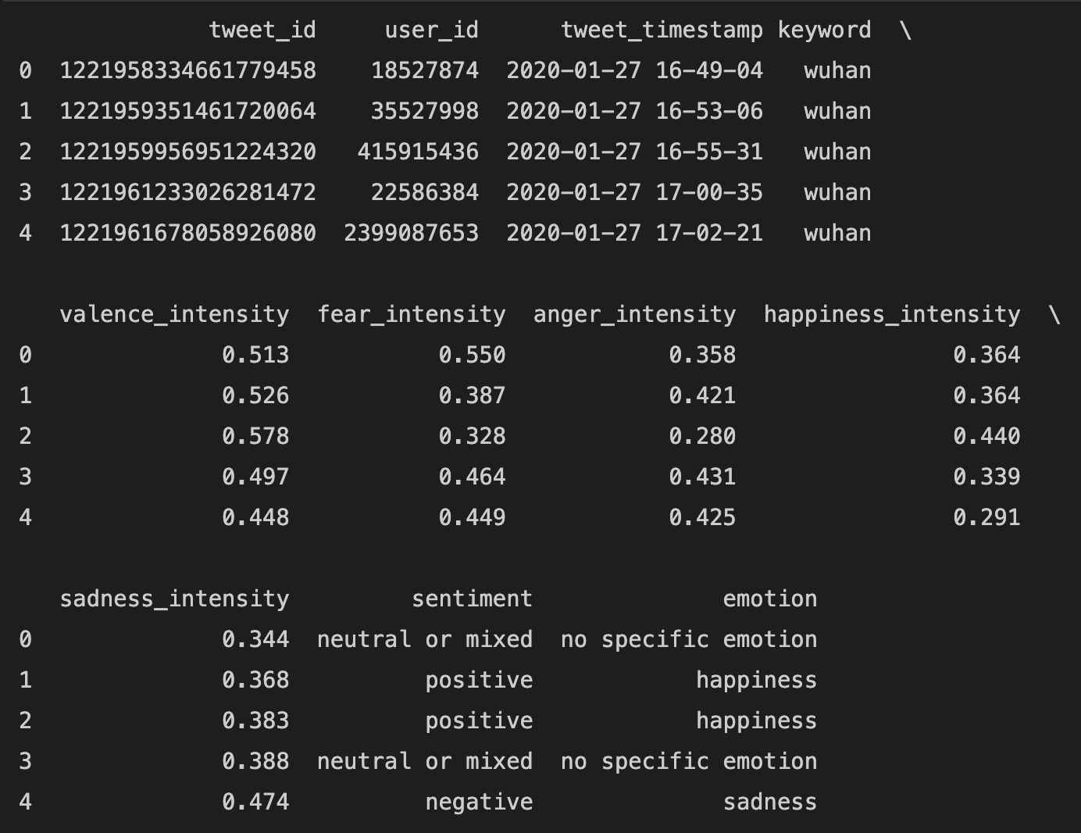
Cleaned Data after dropping null values
Total number of rows was 909,414 after removing dropped rows

Slide 8
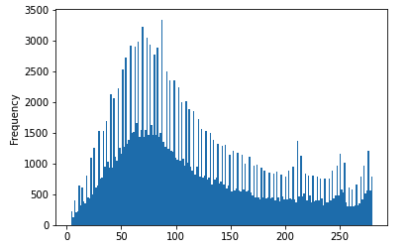
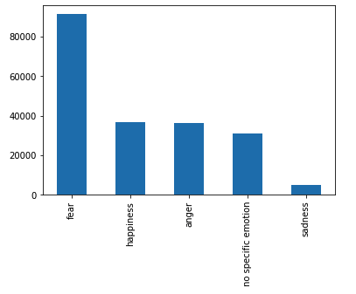
Lengths of the tweets text over the train dataset
Distribution of sentiments in the train dataset

Slide 9
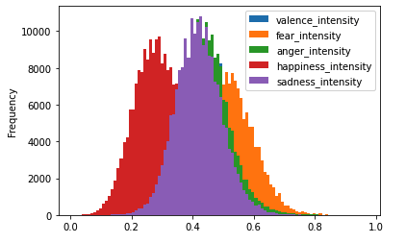
Distribution of the intensities of all the sentiments

Slide 10
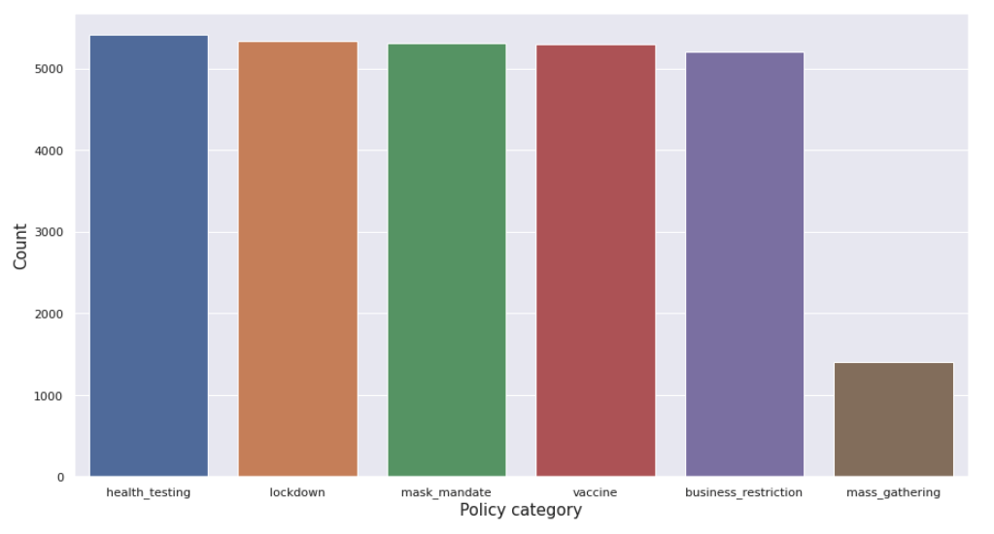
Categorical distribution of policies

Slide 11
Models
Using Naive Bayes and SVM as our baseline model, and we have achieved an accuracy of 63% through the method
The naive baseline that we tried to set in order to proceed with a more complex and advanced deep learning model underperformed significantly without giving any kind of insights regarding the features that were fed into the model.

Slide 12
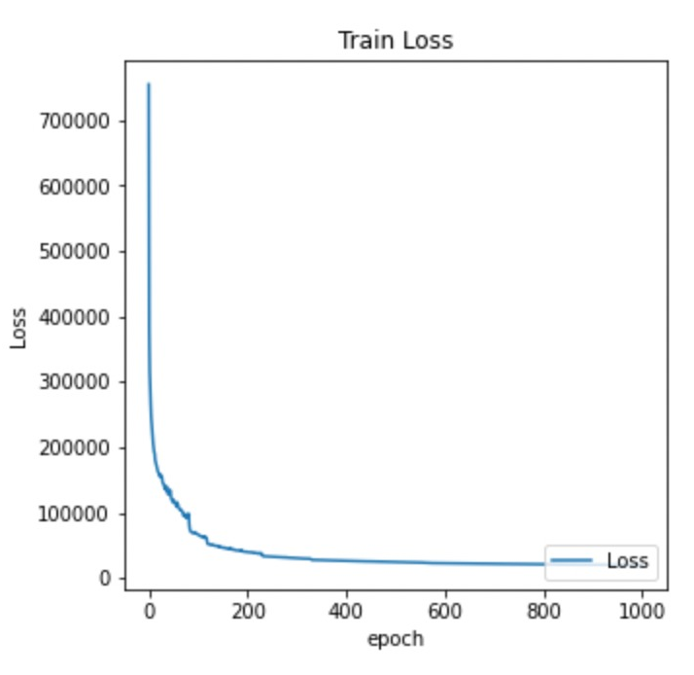
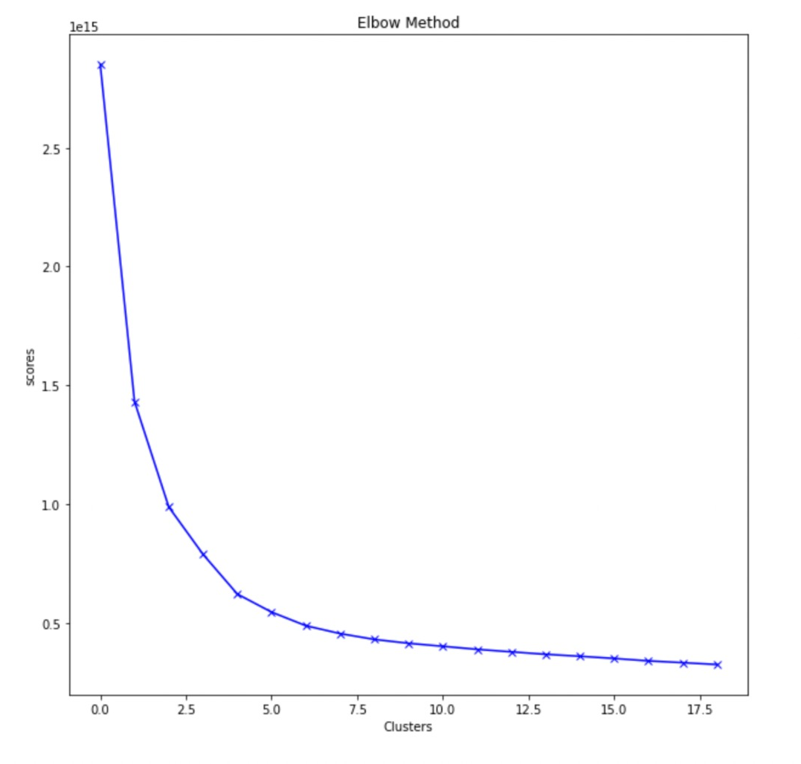
Performance of Unsupervised Model

Slide 13
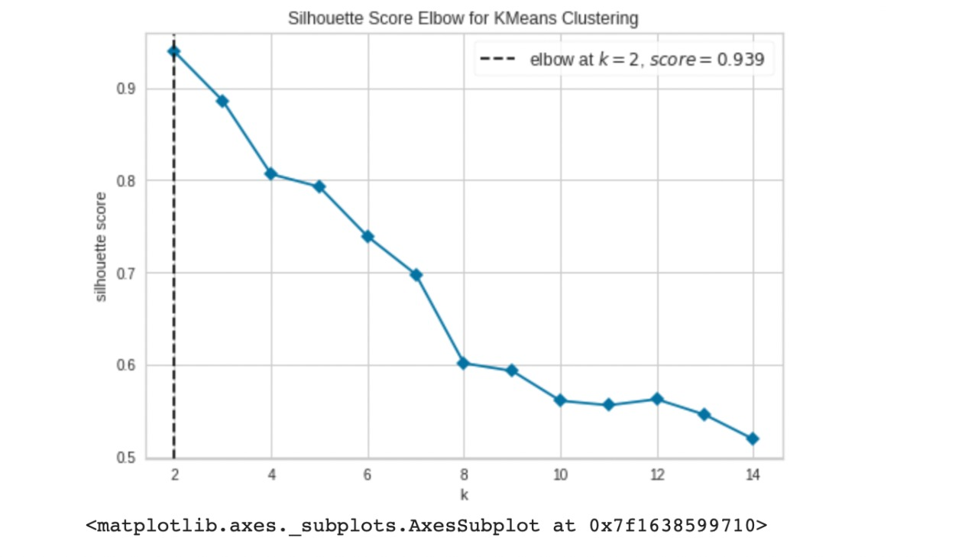
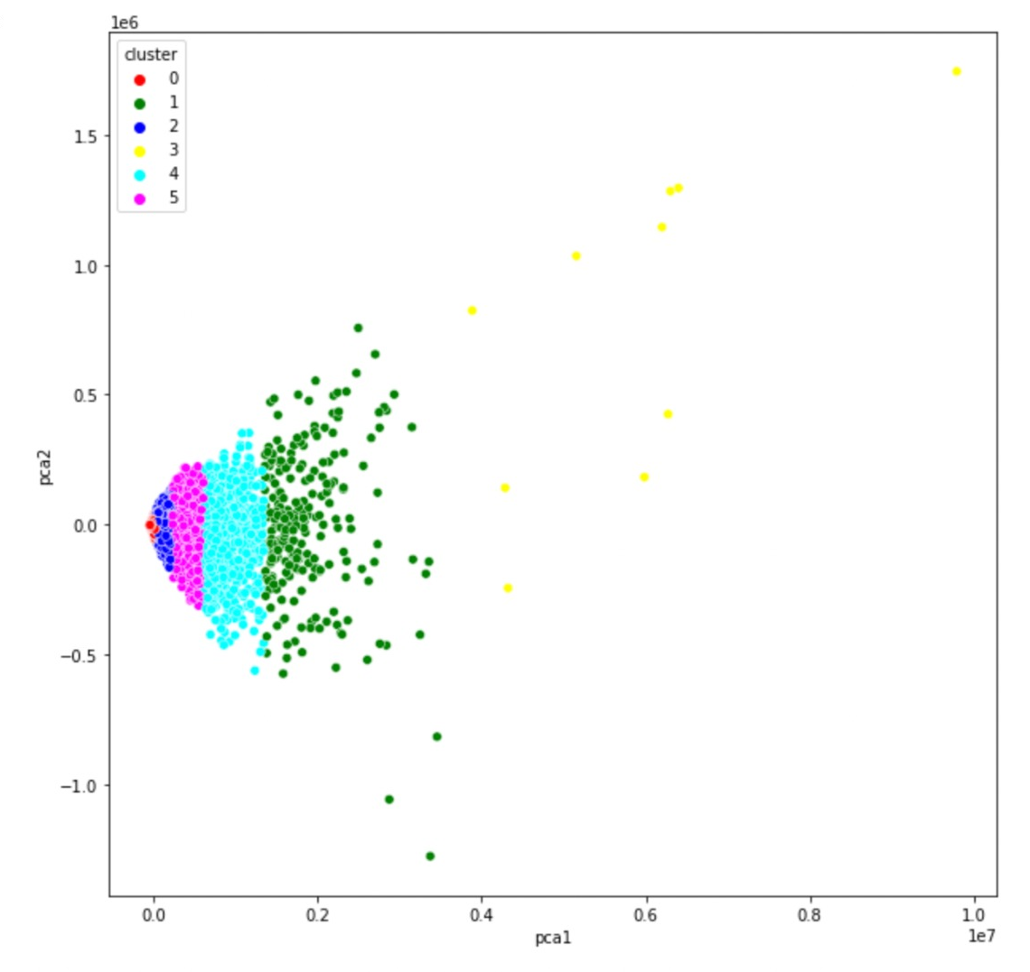
Performance of Unsupervised Model

Slide 14
Methods & Results
We were able to predict the emotion of each sample using
Recurrent Neural Network with LSTM
Bidirectional LSTM
Convolutional Neural Network
Convolutional Neural Network with bidirectional LSTM

Slide 15
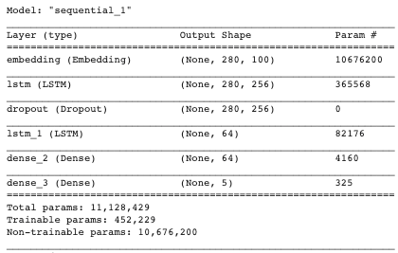
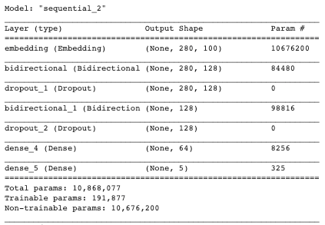
Recurrent Neural Network with LSTM
long-term dependencies are learned (remembered) based on the input sequence.
Cell state (cell activation vector) gates comprise the LSTM unit, along with forget and output gates
gates are responsible for controlling the update procedure of the cell state
Bidirectional LSTM
BiLSTM consists of two LSTMs
One LSTM processes the input sequence from the first element and produces an output vector
The second LSTM processes the input sequence in reverse order and also produces output vectors
Both output vectors have dimension D
The final output vector from BiLSTM with dimension 2D is then created by concatenating two output vectors

Slide 16
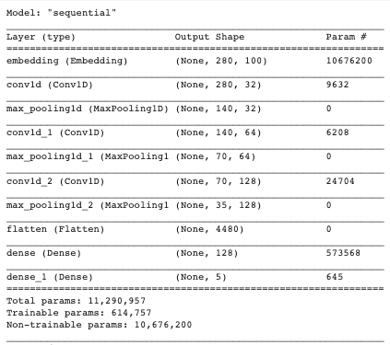
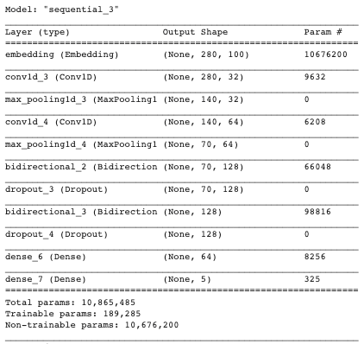
Convolutional Neural Network (CNN)
Trained our model using mini-batches of size 1000 for 50 epochs and we used the Adam optimizer.
Used a Rectified Linear Unit (ReLU) as an activation function in the convolutional layer.
Used 32 filters with a kernel size of 3. A pooling function is applied to each feature map to get a fixed length vector, and max pooling is then applied to extract features. The final classification is determined by a softmax function.
CNN with Bidirectional LSTM
Trained our model using mini-batches of size 1000 for 50 epochs and we used the Adam optimizer.
Used a Rectified Linear Unit (ReLU) as an activation function in the convolutional layer.
Used 32 filters with a kernel size of 3. A dropout of 0.3 has been set to the 2 bidirectional layers. Added dropout helped overfitting of the model compared to a model without any regulariser.

Slide 17
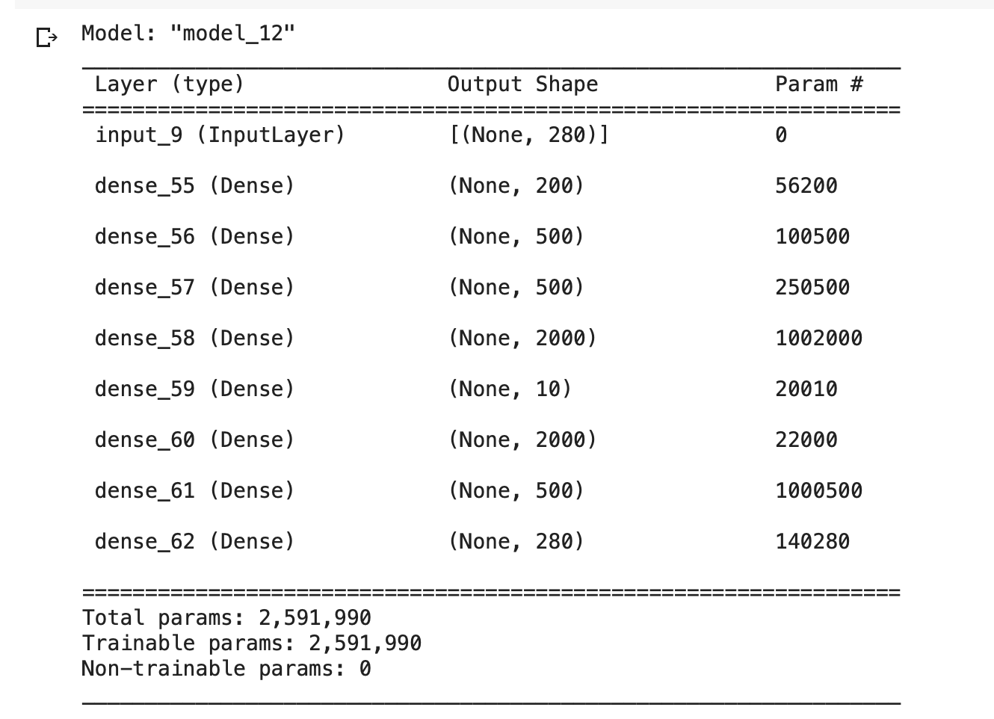
Autoencoder
An autoencoder is a type of artificial neural network used to learn efficient coding of unlabeled data. The encoding is validated and refined by attempting to regenerate the input from the encoding. The autoencoder learns a representation (encoding) for a set of data, typically for dimensionality reduction, by training the network to ignore insignificant data (noise).

Slide 18
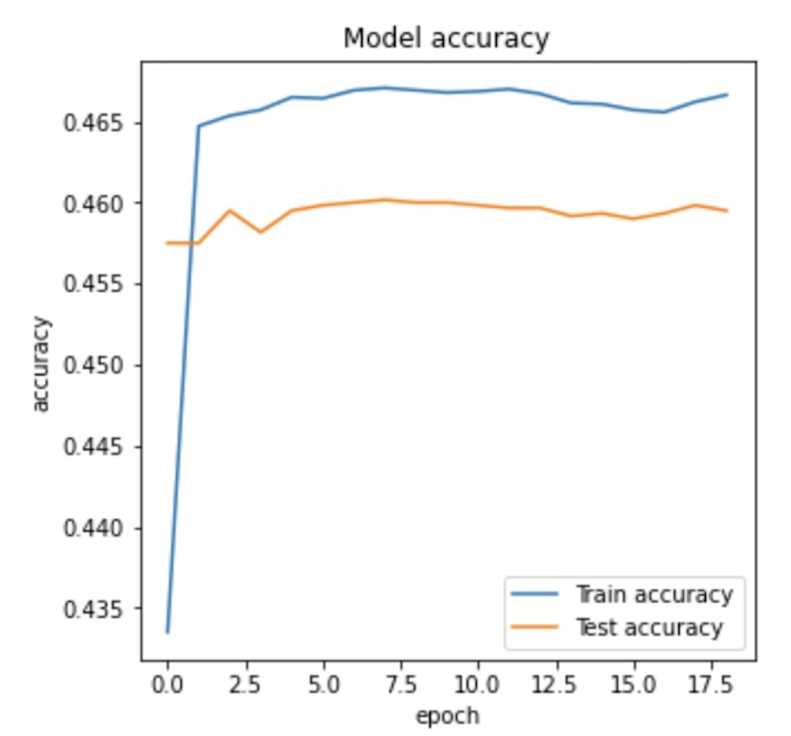
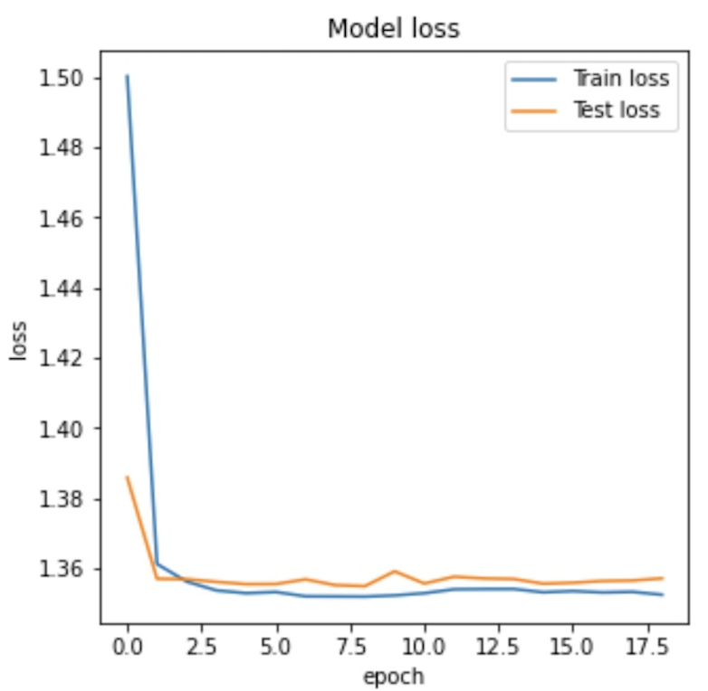
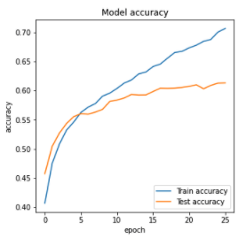
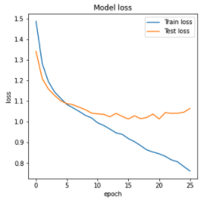
Analysis
Performance of LSTM
Performance of Bidirectional LSTM

Slide 19
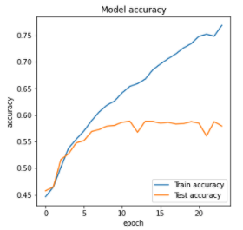
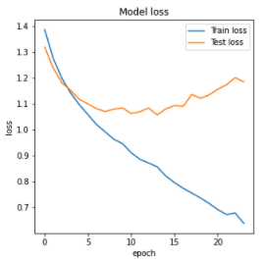
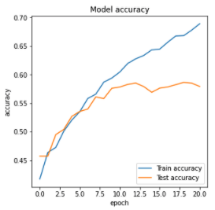
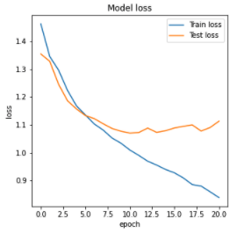
Analysis
Performance of CNN
Performance of CNN with Bidirectional LSTM

Slide 20
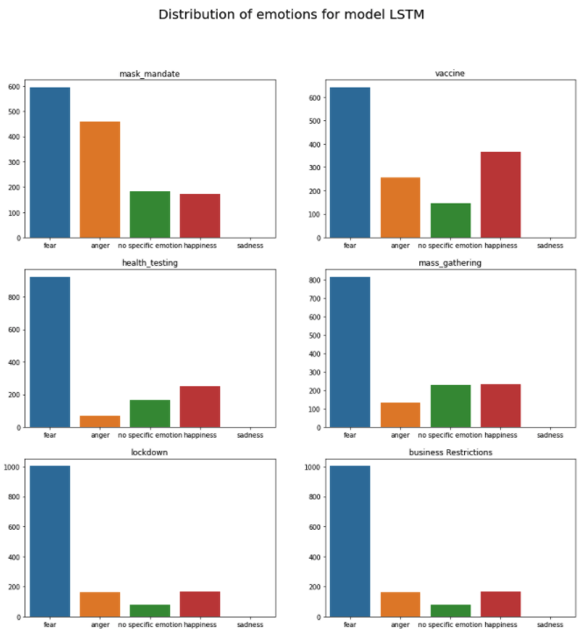
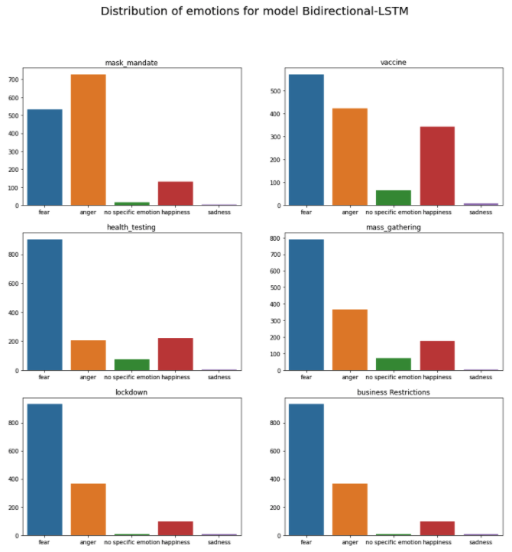
Model predictions of emotions
Performance of LSTM
Performance of Bidirectional LSTM

Slide 21
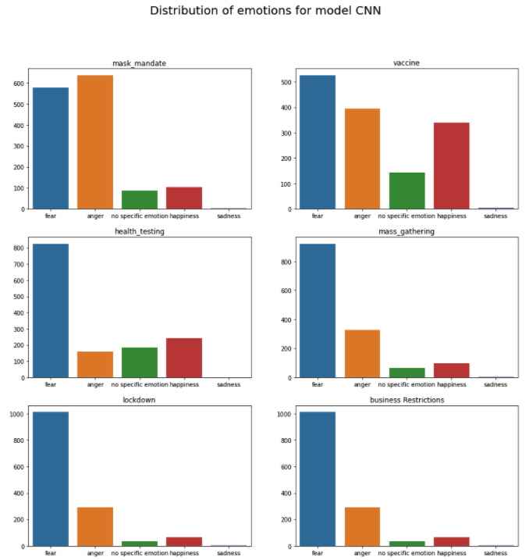
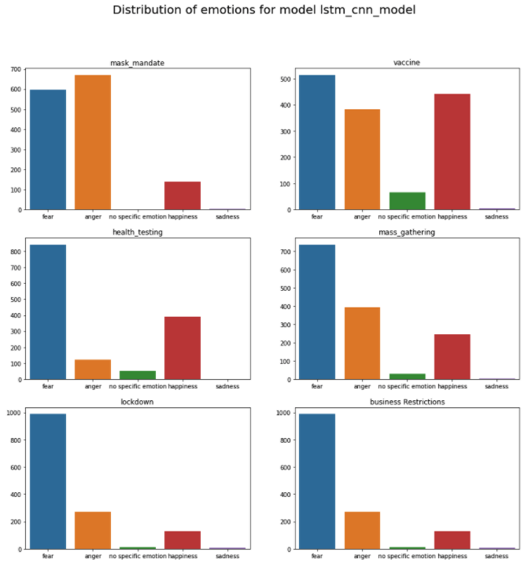
Model predictions of emotions
Performance of CNN
Performance of CNN with Bidirectional LSTM

Slide 22
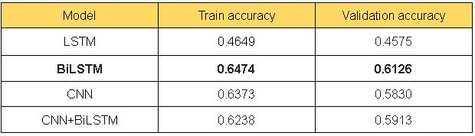
Analysis I
Most dominant emotion expressed by people among all 6 category is 'fear', followed by 'anger'.
With regards to the mask mandate, we see that anger is the dominant sentiment among the people of the United States of America followed by happiness.
Similar patterns of emotions among the people in regard to lockdown and business restrictions.
More people have expressed anger towards policies related to mass gatherings compared to policies on health testing
Interesting observation is that people are more likely to be happy about vaccine policies than any other type of policy.
NOTE: The fact that out of all the 30000 tweets we predicted sentiments on, only a few contained no specific emotion adds validity to our analysis
Analysis II

Slide 23
Conclusion and
Future Scope
Throughout this research project, we have analysed the sentiments of tweets from all over the United States. A similar analysis can also be performed on tweets from other countries as well.
In the future, we might want to attempt another methodology utilizing a Twitter explicit language model to foresee probabilities for every emotion class for the missing objective feeling word in the given information. These probabilities could be utilized as information highlights in our model.
Our work proposes a method by which we can construct a convolutional neural network for taking a look at sentiments based on text. Research can be conducted further, such as considering the use of the word2vec tool and multilayer convolutional neural networks
The analysis of a larger number of training data sets and other types of situation or status analysis can be done.

Slide 24
Thank You !

